Slide 1


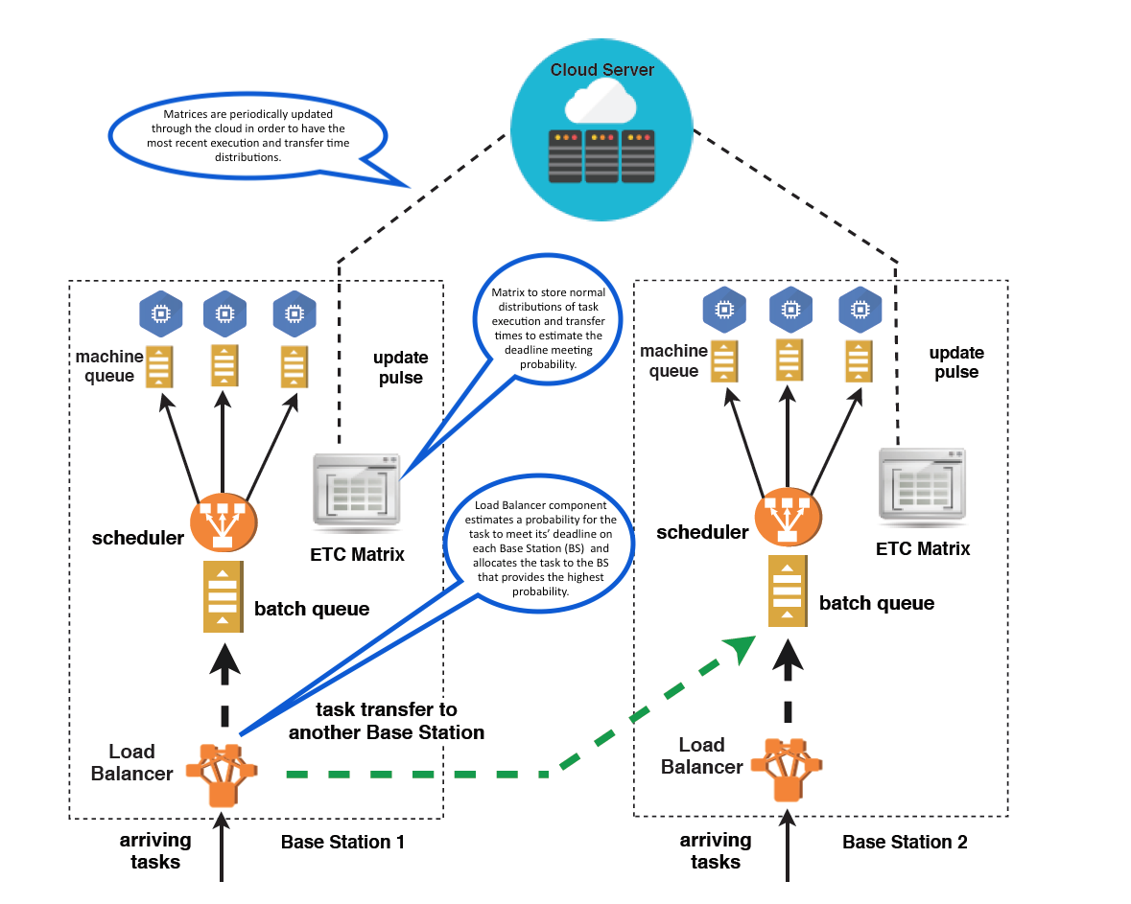
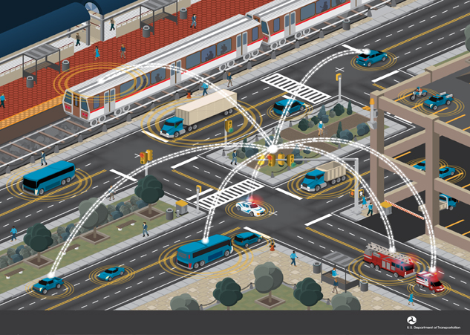
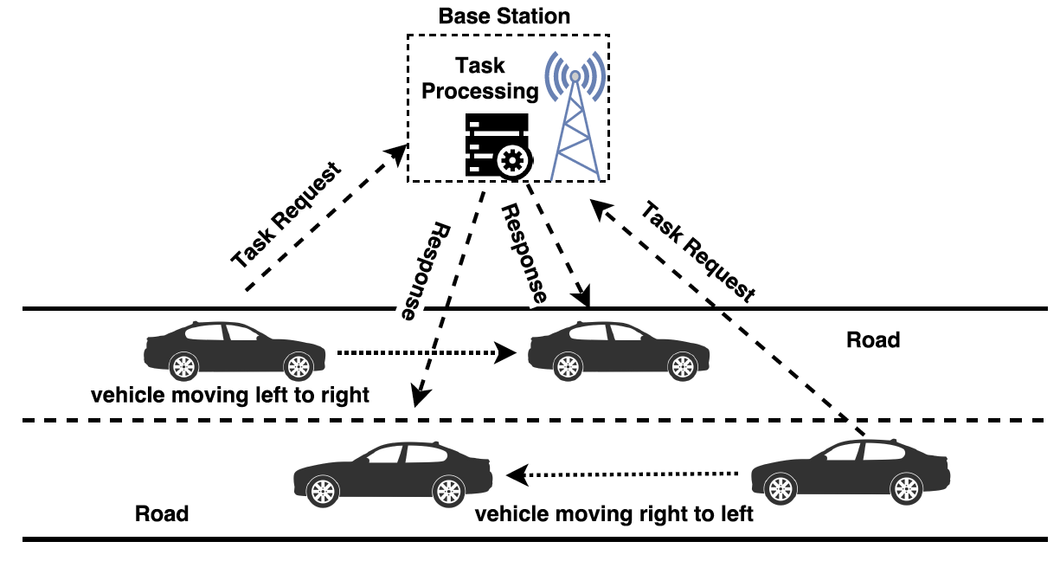
Robust Resource Allocation Model Using Edge Computing for Delay Sensitive Tasks in Vehicle to Infrastructure (V2I) Networks
Anna Kovalenko, Razin Farhan Hussain and Mohsen Amini Salehi
University of Louisiana at Lafayette, High Performance Cloud Computing Lab
Abstract
Proposed Resource Allocation Model
Autonomous vehicles require reliable services to manage hazardous road situations. Such services can be provided by Vehicle-to-Infrastructure (V2I) networks.
When request arrives to a Base Station it enters the Load Balancer.
The Load Balancer allocates arriving tasks between neighboring Base Stations.
Figure 1. Vehicle-to-Infrastructure network. Adapted from Vehicle-to-Infrastructure (V2I) Resources by Intelligent Transportation Systems Joint Program Office of the US Department of Transportation, retrieved from https://www.its.dot.gov/images/Image38.jpg
For example, Disaster Updates or Hazard Alerts have an urgent nature and have no value if executed after a certain time point.
The consequences of even a millisecond delay for such urgent requests can be dangerous, sometimes fatal.
During increased traffic congestion, it is hard for V2I systems to provide optimal service time for urgent requests.
The goal of our research is to improve the ability of V2I systems to maintain optimal performance level during unusually dense service request arrival.
The main question: How to allocate arriving requests among the Base Stations so the number of requests meeting their deadline is maximized?
Conclusion
Allocation decision is made based on a calculated probability of the arriving request to be served in time on several neighboring Base Stations.
Our model is tested against the Baseline which always allocates arriving task to a receiving Base Station.
Figure on the left represents results for overall system performance while increasing oversubscription level.
Our model provides noticeably better results when the number of vehicles is less than or equal to 100. Otherwise, it's performance decreases as well as the Baselines’ performance. Overall, our model performs 2-5 % better than the Baseline.
Proposed model showed significant improvement for urgent service requests. The figure above shows, that our model performs noticeably better. When the number of vehicles is low, it allows for up to 50 % improvement. With an increased amount of vehicles up to 20 % performance improvement is present.
Thus, the results of our research prove that the proposed model offers a better, more robust allocation algorithm.
Performance Evaluation
Scenario
Figure 2. A Vehicle to Infrastructure (V2I) scenario where vehicles send requests to a Base Station and receive the response. A Base Station is a roadside unit with communicational and computational abilities.

